Slide 1
Parent Training
©2014 MindWise Innovations, a division of Riverside Community Care
Notes:
Introduce yourself and all school-based mental health staff who will be involved in suicide prevention.

Slide 2
Prevalence of Youth Suicide
In the past year, U.S. students report:
Seriously considered attempting suicide (17%)
Making a plan about how they would attempt suicide (14%)
Attempting suicide one or more times (7%)
Attempting suicide that resulted in an injury, poisoning, or overdose that had to be treated by a doctor or nurse (2%)
Notes:
Prior to the training, you may modify this slide to include local data. State specific data may be found: https://www.cdc.gov/healthyyouth/data/yrbs/results.htm or you may have school/district specific data to share.
This data is taken from the national Youth Risk Behavior Survey that is administered by the CDC every 2 years. The survey is anonymous self-report and is believed to be a very reliable indicator of all sorts of health behaviors such as wearing a seat belt, substance use, etc.
Use this slide to educate your audience on how common suicidal thoughts and feelings are in schools around the country and locally.

Slide 3
Raising Awareness
Thoughts of suicide are often hidden because youth are confused, embarrassed or ashamed
Research shows:
50-90% of parents were unaware of their child’s suicidal thoughts
60-95% of parents were unaware of suicide attempts reported by their child
We must work together to watch for warning signs and connect children to help when needed; please talk to our school’s counseling staff if you are concerned
Notes:
Though suicidal thoughts and behaviors are relatively common, very few parents are aware of their child’s suicidal thoughts and even suicide attempts. Teens tend to hide suicidal thoughts from adults but they are likely to show warning signs to their friends. We are committed to training all of our students to intervene when they are worried about a friend.
All adults can work together to watch for signs of suicide in all students. Parents are trusted adults for their own children and for many other children in the community.
(Breton et al., 2002; Sourander et al., 1999; Velez & Cohen, 1988; Walker, Moreau, & Weissman, 1990; Kashani, Goddard, & Reid, 1989)

Slide 4
Youth Suicide Prevention
What increases risk?
What are the common warning signs?
What can parents do?
What is our school doing?
Notes:
First we’ll take a look at common risk factors and warning signs for teens at risk. Then we’ll talk about what you can do at home to support our efforts here at school to educate students about suicide prevention and take action when concerned about a friend.

Slide 5
Mental Health
Over 90% of people who die by suicide have a mental health disorder (most commonly depression)
Depression is treatable but without treatment, a young person may begin to feel so hopeless that they consider suicide
Talk to your child’s doctor or our school’s counseling staff if you are concerned
Notes:
Mental health: Over 90% of people who die by suicide have a mental health disorder (most commonly depression). These mental health conditions are treatable but many kids struggle without getting help. When depression goes untreated, a young person may begin to feel so hopeless that they consider suicide. Depression can be hard to see. It doesn’t always look like a sad mood. Talk to your child’s doctor or your school’s counseling staff if you are concerned.

Slide 6
Substance Use
Many young people who struggle with depression also struggle with alcohol and/or drug use
Talk to your child about the dangers of using alcohol or drugs to cope with negative emotions
If you are aware of your child using substances, seek support
Notes:
Substance use: Many young people who struggle with depression also struggle with alcohol and/or drug use. Talk to your child about the dangers of using alcohol or drugs to cope with negative emotions. If you are aware of your child using substances, seek support.

Slide 7
Non-Suicidal Self-Injury
Some people use self-injury to try to manage emotional pain
Even though self-injury isn’t the same as a suicide attempt, it is a risk factor
Seek professional help for self-injury as soon as possible
Non-suicidal self-injury is when someone hurts their body on purpose without the intention of dying
Notes:
Non-suicidal self-injury: While some people turn to drinking and/or drugs to deal with negative emotions, some people use self-injury to manage emotional pain. Non-suicidal self-injury is when someone hurts their body on purpose without the intention of dying. Cutting is a common form of self-injury. Even though self-injury isn’t the same as a suicide attempt, it is a risk factor. Just like other mental health concerns, it is best to seek professional help for self-injury as soon as possible.

Slide 8
Access to Guns
Firearms used in youth suicides usually belong to a family member.
Suicide crises are often short-term but having access to a gun makes it easier to carry out the act in an instant
Reduce suicide risk by not storing a gun in your home. If you choose to keep a gun in your home, keep it locked, unloaded, and lock/store ammunition separately
Handout: Youth Risk Factors, Warning Signs and Precipitating Events
Notes:
Access to guns: Suicide crises are often short-term but having access to a gun makes it easier to carry out the act in an instant. Many people keep unlocked guns in their homes, making them easy to get, quick, and deadly for any young person. Reduce suicide risk by not storing a gun in your home. If you choose to keep a gun in your home, keep it locked, unloaded, and lock/store ammunition separately.
Every study that has examined the issue to date has found that within the U.S., access to firearms is associated with increased suicide risk.
90% of people who survive a suicide attempt never go on to die by suicide later. But if someone attempts suicide with a gun, they are likely to die. They don’t get the second chance to seek help.
Firearms used in youth suicide usually belong to a family member (82%). It is critically important that parents understand the risk increased risk for suicide when guns are accessible in the home.
Note the handout provided that includes a full list of risk factors and warning signs.

Slide 9
Warning Signs: Watch and Listen
Watch for significant changes in behavior, particularly:
Extreme withdrawal
Increased or decreased sleep
Anger or hostility that is out of character or out of context
Increased agitation or irritability
Listen for:
Talk about suicide
Sounding hopeless
Sounding overwhelmed by emotional pain or distress
Notes:
While many teens don’t directly reach out to their parents or teachers for help, they have a way of showing us that they are really struggling. Watch out for these key warning signs. It is important to note that some teens do talk about suicide. This is a strong warning sign that a teen is planning to attempt suicide. Parents must be encourage to take immediate action if they see these warning signs in any child.

Slide 10
It Is Okay to Talk About Suicide
MYTH:
Talking to youth about suicide or asking a teen if they are suicidal is risky because it might put the idea in their head.
FACT:
You don’t give a suicidal person morbid ideas by talking about suicide
The opposite is true. Bringing up the subject of suicide and discussing it openly is one of the most helpful things you can do
Handout: Youth Depression and Suicide Myths and Facts
Notes:
We focus on this myth because it is the most important one to bust: Many people worry about discussing suicide with their child or even through educational programs because they worry that they could put the idea into someone’s head. We know that this is absolutely not true. The reason this myth is such a problem is because the opposite is actually the truth. It is important for us to be able to talk openly about suicide in the classroom and with individual students so that they may feel comfortable coming forward when they need support.”
Refer the audience to the handout in blue. The handout includes additional common myths that can be discussed during the training or reviewed individually.

Slide 11
Talking To Your Child
We are encouraging students to tell a trusted adult at home or at school if they are worried about themselves or a friend
Talking about these issues can be tough for families; mental health isn’t often discussed openly like physical health
You can help protect your child and their friends by opening up a conversation about mental health
Notes:
Now that we’ve debunked the common myth that talking about suicide could be dangerous, we encourage you to use this opportunity to talk to your child about mental health. We encourage you to go home tonight and share what we discussed with your child and ask them about any concerns they might have. Your child could be doing well emotionally but concerned about a friend. You never know what you may uncover by opening up the conversation.

Slide 12
Our School’s Role in Suicide Prevention
Our school has chosen an evidence-based approach to help prevent youth suicide: SOS Signs of Suicide
SOS includes training and resources for faculty/staff and parents
Most importantly SOS focuses on training students to identify warning signs and seek help for themselves or a friend
Notes:
Introduce SOS and highlight it’s focus on student education. Feel free to share details about your school’s specific plan to train faculty/staff and any other suicide prevention initiatives going on at school in conjunction with SOS.

Slide 13
Why Universal Prevention?
Overrides adults’ assumptions about who may be most at risk so that no student flies under the radar
Raises awareness and debunks myths about mental health throughout the school so that students may feel comfortable reaching out
Trains all students to recognize warning signs and seek help for friends so that peers can help each other
Notes:
Universal prevention is important because we can’t pick and choose every child who may be at risk. While adults can look out for warning signs, we want to make sure that we aren’t missing any students who may be struggling silently.
If we want students to feel comfortable seeking help, we need their peers to understand that depression and suicidal thinking are not character flaws or something to be ashamed of- reducing stigma across the whole school
We know that students are more likely to disclose to a friend rather than directly to an adult. We want all of those friends to be trained to get that student to an adult to get help

Slide 14
Why SOS Signs of Suicide?
Only universal school-based suicide prevention program that has shown a reduction in self-reported suicide attempts in randomized controlled trials
Compared with students in the control group, students who received SOS:
were 64% less likely to report a suicide attempt in the next 3 months
reported more favorable attitudes toward getting help for themselves or friends for depression and/or suicidal thoughts
Schilling et al., 2016
Notes:
There have been 3 main studies on SOS. Each one used a randomized controlled design (intervention group received the program, control group did not). All studies demonstrated improvements in students’ attitudes toward getting help and reduced likelihood of attempting suicide.
The full citations for all 3 studies are on the final slides of the slide deck. If you get specific questions about the research during your training, encourage participants to read the articles and/or contact SOS staff.

Slide 15
Teaching Students to ACT
Acknowledge that you are seeing signs of depression or suicide and that it is serious
Care: Let your friend know how much you care about them
Tell a trusted adult so your friend can get help
Notes:
The main teaching message for students is: ACT (Acknowledge, Care, Tell). Whether students are worried about themselves or a friend, they are encouraged to ACT.

Slide 16
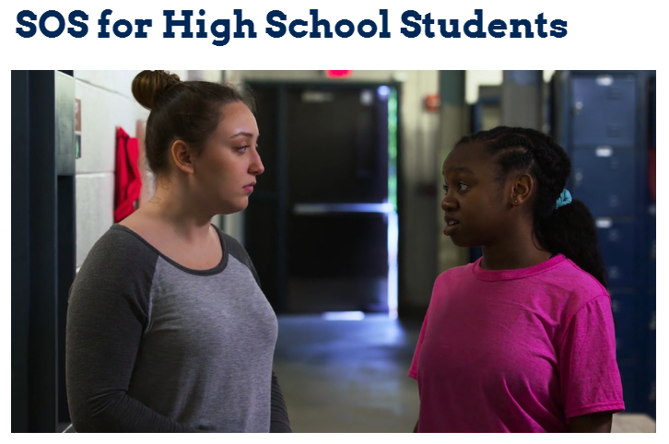
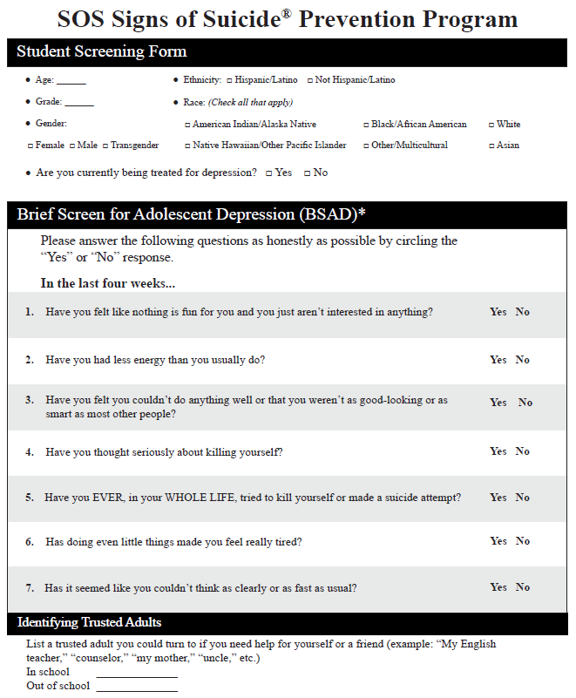
SOS Components
Suicide prevention education: video and guided discussion
Mental health screening: depression and signs of suicide
Notes:
Highlight the 2 main components of SOS.
Education: Age appropriate videos focus on a peer-to-peer message- teaching students how to identify signs and symptoms in themselves and their friends and then giving them the tools for how to react. Young people are likely to talk to each other and will need encouragement to take these issues to an adult. We want all students to be prepared to respond if they are concerned about a friend.
Screening: Following the video and guided discussion, students complete a mental health screening form that further educates them on the symptoms of depression and includes direct questions about suicidal thoughts and behaviors. Mental health screening is an educational tool that teaches students about the symptoms of depression and encourages them to seek help based on their self-assessment.
Some parents may be concerned about depression/suicide screening because of a common myth: asking kids about suicide (in person or on a survey) could put the idea in their head. Rest assured that evidence-based suicide prevention programming, including screening, is safe and effective. After years of research, there is no evidence that screening youth for suicide induces suicidal thinking or behavior (Gould et al., 2007).
Mental health screenings are for educational purposes and do not provide a diagnosis. The goal of in-school screening is for students to identify symptoms consistent with depression and/or suicide risk and for school staff to advise a complete professional evaluation.

Slide 17
The Value of Screening
“Screening for possible suicidal behavior in students presents a variety of logistical challenges, but the fact remains that student screening likely represents the most direct and efficient way to identify potentially suicidal youth, and it is a critically important element of any public health approach to school-based suicide prevention.”
– David Miller, Past President American Association of Suicidology 2016 Keynote
Notes:
Acknowledge any concerns that parents may have about mental health screening and reinforce the reason your school is conducting screening: screening is a safe and effective way to reach students in need.

Slide 18
Our Plan for SOS
When will you implement SOS?
Who will be involved? Classroom teachers? Counseling staff delivering in certain classrooms?
Will you be doing anonymous or identified screening?
How will follow-up work? Who will be involved?
Notes:
PRIOR TO THE TRAINING, COMPLETE THIS SLIDE WITH ANY RELEVANT INFORMATION ABOUT YOUR SCHOOL’S PLAN TO FACILITATE SOS.

Slide 19
Our School Policy
Provide parents with any specific information they need to know from your school policy for handling crisis
Notes:
If your school needs help developing your policy, review the Model School Policy developed by leaders in the field of suicide prevention available in the SOS Portal and at https://afsp.org/wp-content/uploads/2016/01/Model-Policy_FINAL.pdf

Slide 20
Access SOS Portal
Visit sossignsofsuicide.org/parent
View clips of the program videos to learn more about the program your child is receiving
Take an anonymous mental health screening on behalf of your child and receive immediate results indicating whether it is likely that your child is experiencing depression
Notes:
All parents can visit sossignsofsuicide.org/parent to learn more about the program your children will receive.
When parents access the portal, they can watch clips of the student videos, read more about youth suicide and take a mental health screening on behalf of their child. This anonymous screening allows them to check in on their child’s mental health while previewing the screening their child will complete in school.

Slide 21
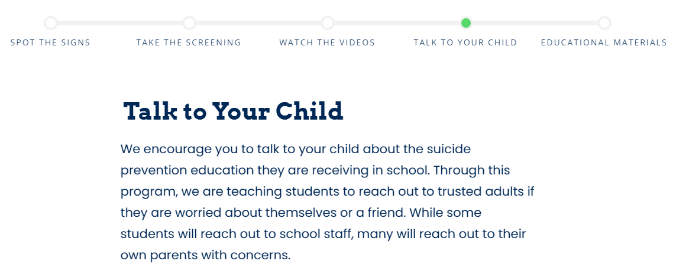
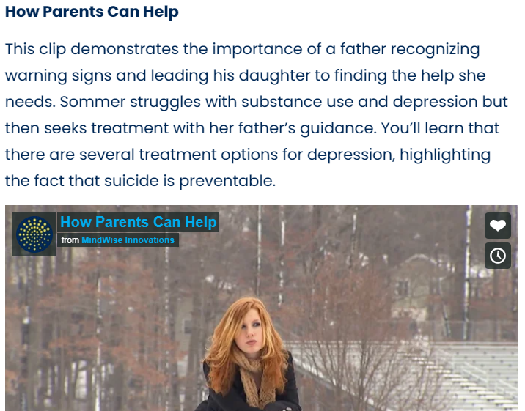
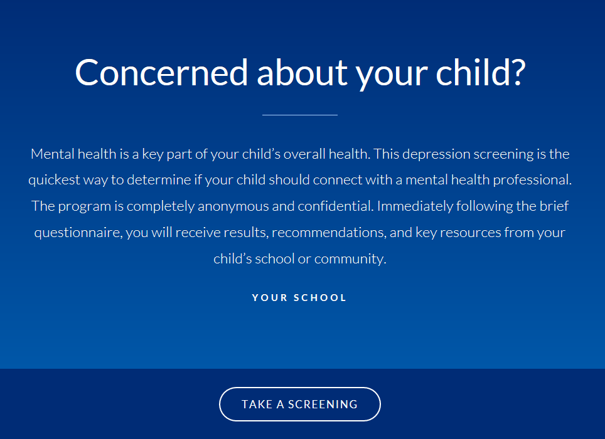
Parent Access to SOS Portal
Notes:
If time permits, go to sossignsofsuicide.rog/parent to demonstrate how parents can navigate.

Slide 22
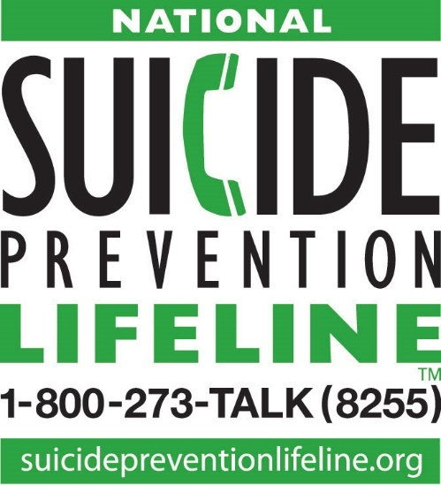
National Resources
Call 1-800-237-TALK (8255) National Suicide Prevention Lifeline: for 24/7, free and confidential support for people in distress, prevention and crisis resources for you or your loved ones.
Text ACT to 741741 Crisis Text Line for 24/7, free and crisis support.
Text ACT to 741741.
Handout: Local Resources
Notes:
Remember, help is always available. Both the suicide prevention lifeline and the crisis text line are available 24/7 for yourself or child. Please contact our school mental health staff so that we can help.
Provide parents with a handout including local resources.

Slide 23
Questions?
Carrie Schaefer, 8th Grade School Counselor
carrie.Schaefer@apsva.us
Janae Rittenhouse, Director of Counseling
janae.Rittenhouse@apsva.us
Lisa Moore, 8th Grade Administrator
lisa.moore@apsva.us
Ellen Smith, DHMS Principal
ellen.smith@apsva.us
Notes:
Be sure to leave time for questions. Encourage questions about the SOS program and about your school’s procedures.

Slide 24
References: SOS Program Evaluations
Aseltine, R., James, A,, Schilling, E.A., & Glanovsky, J. (2007). Evaluating the SOS suicide prevention program: A replication and extension. BMC Public Health 18(7), 161.
Aseltine, R.H., and DeMartino, R. (2004). An outcome evaluation of the SOS suicide prevention program. American Journal of Public Health 94(03), 446-51.
Schilling, E.A., Aseltine, R.H. & James, A. (2016). The SOS suicide prevention program: further evidence of efficacy and effectiveness. Prevention Science 17(2), 157-66.

Slide 25
References: Parent Education
Klaus, N. M., Mobilio, A., King, C. A. (2009). Parent-adolescent agreement concerning adolescents’ suicidal thoughts and behaviors. Journal of Clinical Child & Adolescent Psychiatry, 32(2), 245-255.
Spicer, R. S. and Miller, T. R. (2000). Suicide acts in 8 states: Incidence and case fatality rates by demographics and method. (2000). American Journal of Public Health, 90(12), 1885-1891.
Brent, D. A., Perper, J. A., Allman, C. J., Moritz, G. M., Wartella, M. E., & Zelenak, J. P. (1991). The presence and accessibility of firearms in the homes of adolescent suicides. Journal of American Medical Association, 266(21), 2989-9295.
Miller, M., Azrael, D., & Hemenway, D. (2002). Household firearm ownership and suicide rates in the United States. Epidemiology, 13(5), 517-524.
Notes:
Citations for parents’ awareness of suicidal behavior and for correlation between gun accessibility and death by suicide.

